Slide 1
Self-Encrypting Drive (SED) & sedutil
Engineering 3 KC Lin
V1.0
2020/03/13

Slide 2
Agenda
Self-Encrypting Drive (SED)
Sedutil

Slide 3
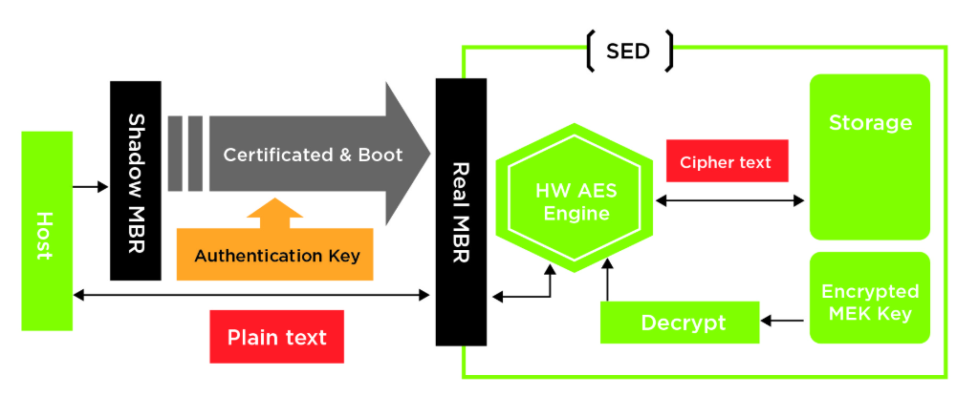
Self-Encrypting Drive (SED)
Self-encrypting drive (SED) is now common when referring to HDDs/SSDs with built-in full-disk encryption. OPAL is a set of specifications for self-encrypting drives developed by the Trusted Computing Group.

Slide 4
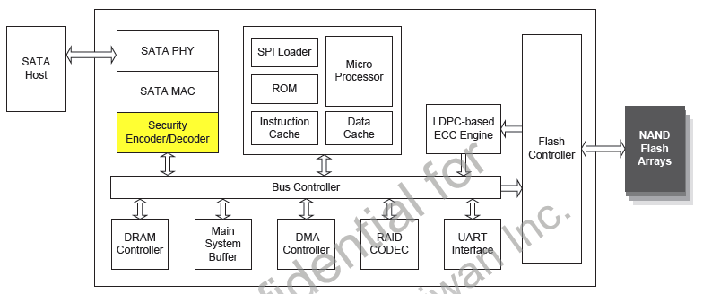
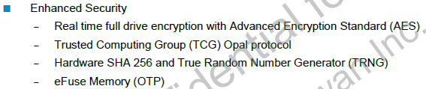
SM2259 Security function

Slide 5
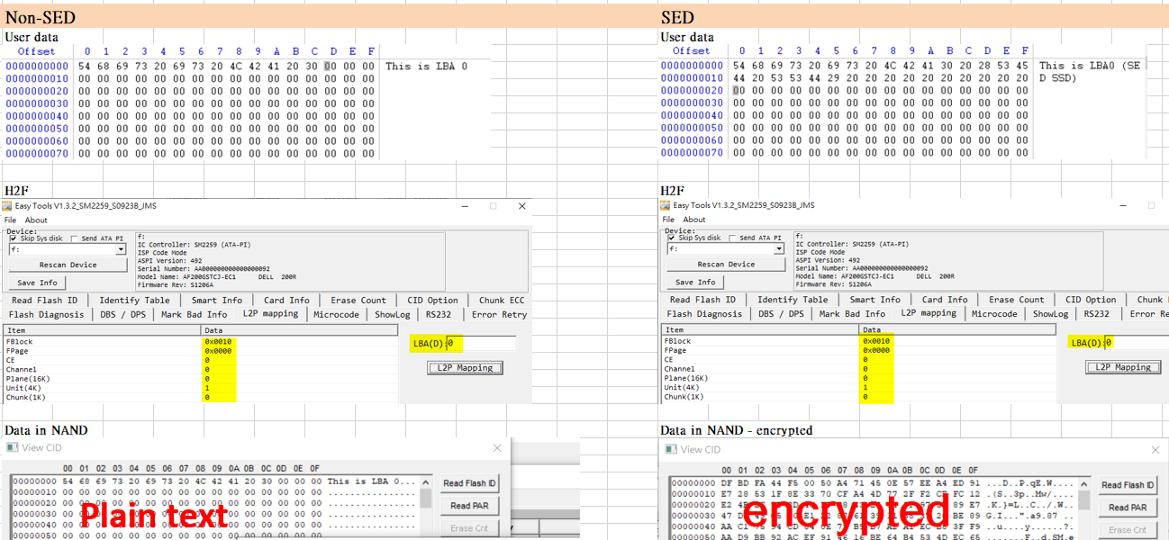
SM2259 Security function

Slide 6
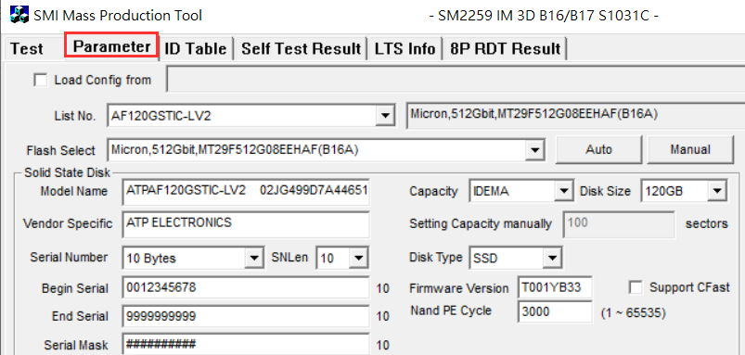
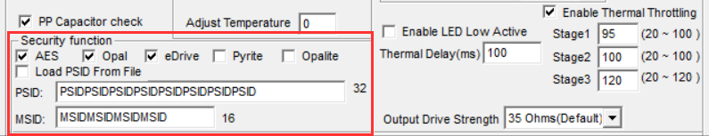
SM2259 TCG/OPAL setting
To enable AES functions: MPTools -> Parameters -> Security function

Slide 7
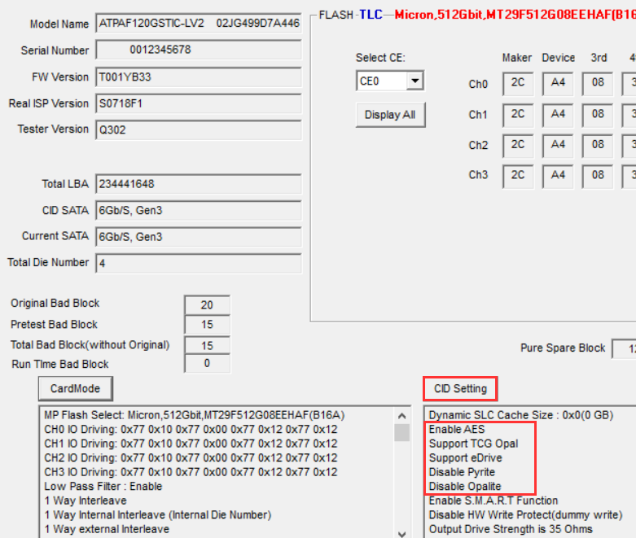
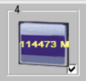
SM2259 TCG/OPAL setting
After drive initialization, check “security function” on MPTool -> SSD information -> CID setting
Click

Slide 8
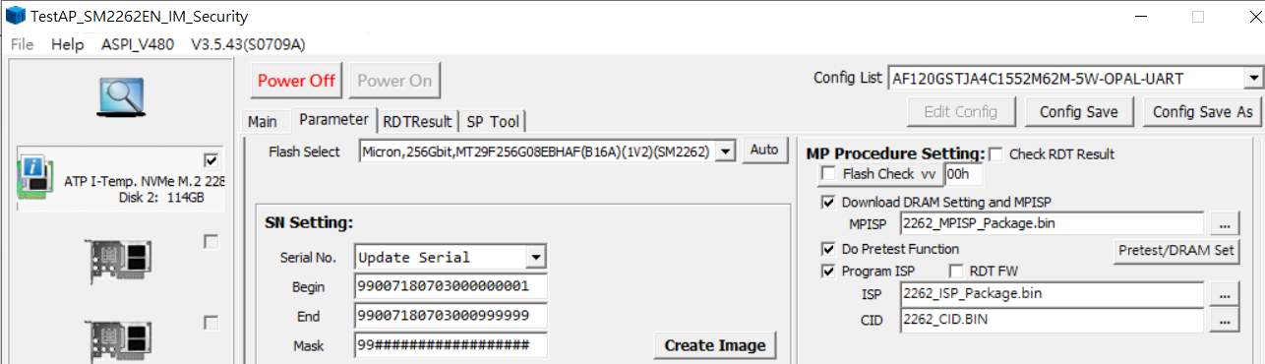
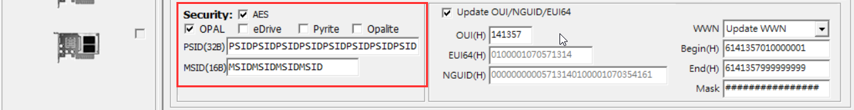
SM2262 TCG/OPAL setting
To enable AES functions: MPTools -> Parameters -> Security

Slide 9
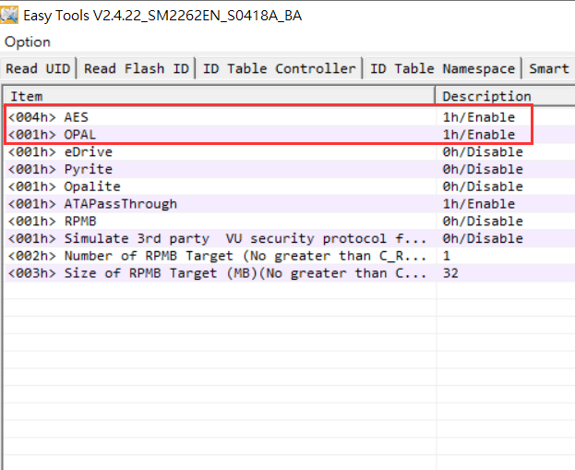
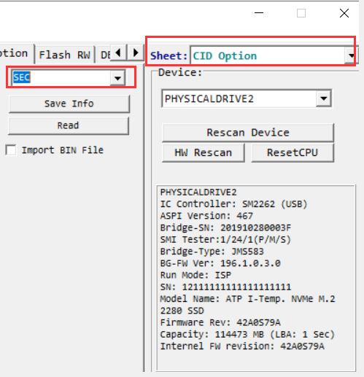
SM2262 TCG/OPAL setting
After drive initialization, use EZTool to check “security function”: EZTool -> CID Option -> SEC

Slide 10
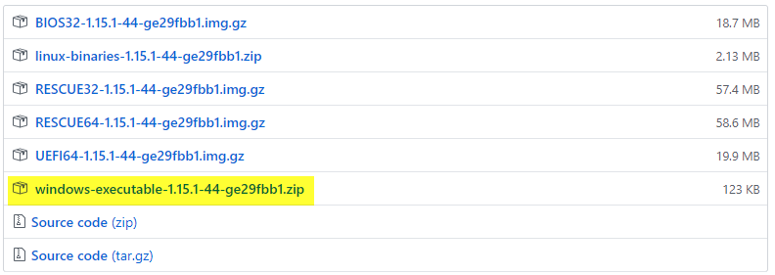
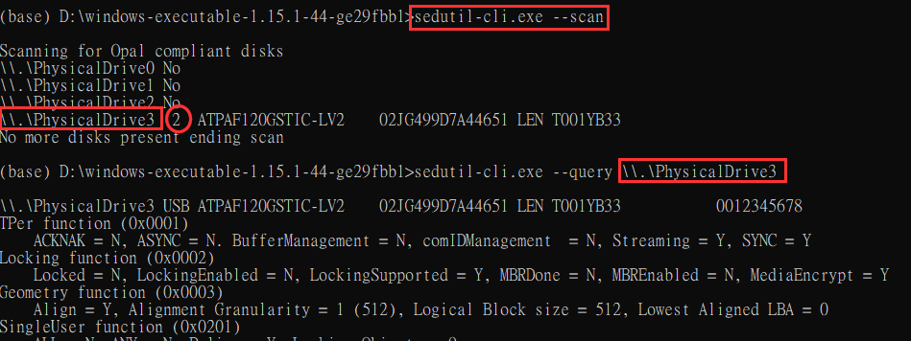
sedutil installation – Windows executable
<1> download from https://github.com/ChubbyAnt/sedutil/releases
<2> run sedutil-cli.exe from command line (as administrator)

Slide 11
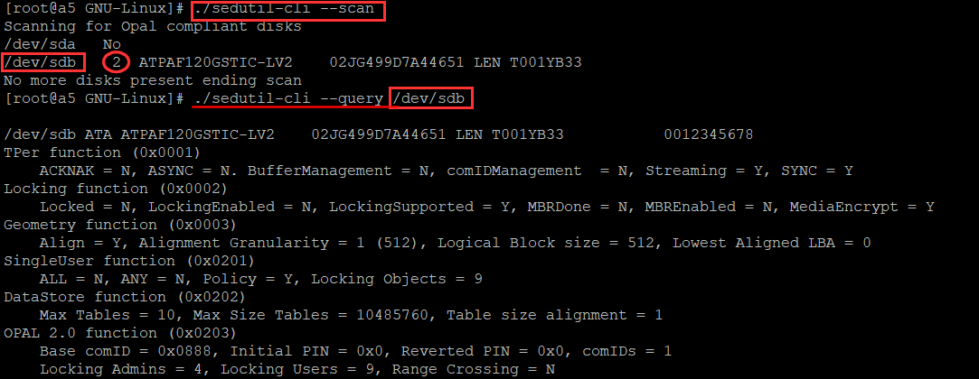
sedutil installation – Linux executable
<1> download from https://github.com/ChubbyAnt/sedutil/releases $ wget https://github.com/Drive-Trust-Alliance/exec/blob/master/sedutil_LINUX.tgz $ tar zxvf sedutil_LINUX.tgz $ cd sedutil/Release_x86_64/GNU-Linux <2> run sedutil from command line

Slide 12
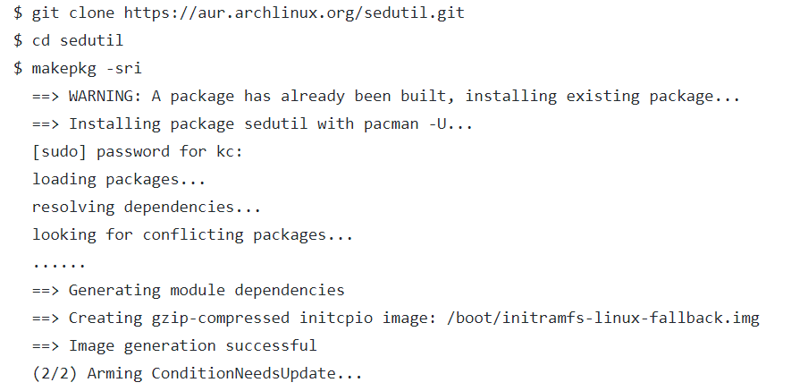
sedutil installation – Linux install
CentOS: ref. https://centos.pkgs.org/7/epel-x86_64/sedutil-1.15.1-1.el7.x86_64.rpm.html $ wget https://download-ib01.fedoraproject.org/pub/epel/7/x86_64/Packages/s/sedutil-1.15.1-1.el7.x86_64.rpm
$ rpm -Uvh sedutil-1.15.1-1.el7.x86_64.rpm
$ yum install sedutil ArchLinux: ref. https://aur.archlinux.org/packages/sedutil/

Slide 13
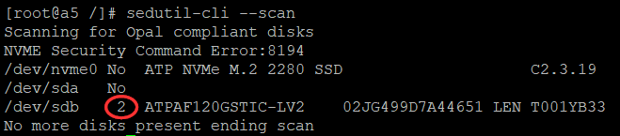
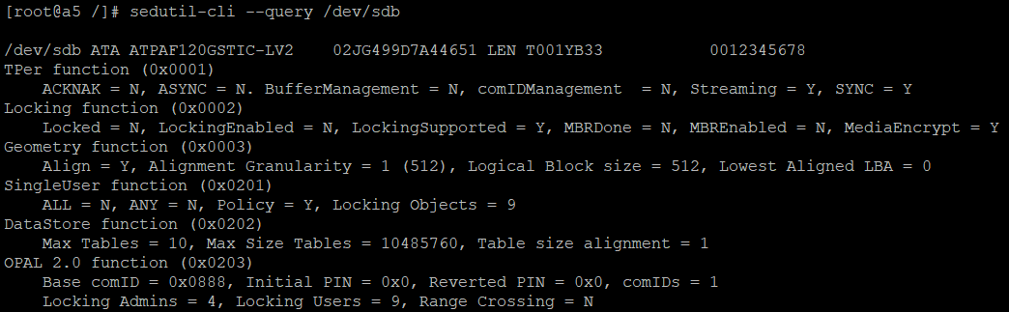
sedutil commands – check OPAL
sedutil-cli --scan : scan the system and report on TCG disks
[Note] 2 means TCG supported
sedutil-cli --query : display details of the devices TCG SSC support For non-SED drive:
For SED drive:

Slide 14
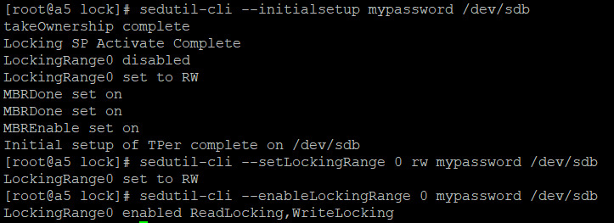
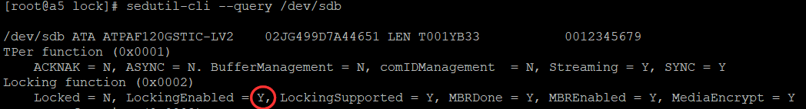
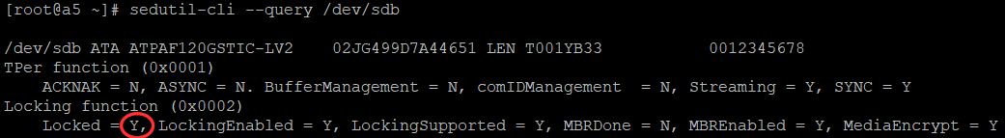
sedutil commands – initial
sedutil-cli --initialsetup : prepare the drive for msed management
Power off -> on
*** Drive locked after power cycling, data encrypted

Slide 15
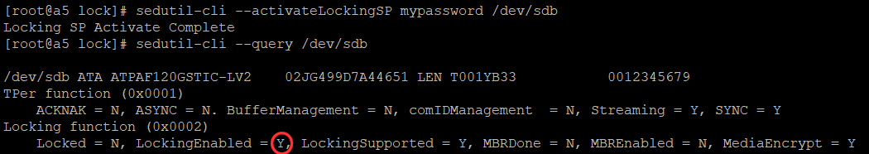
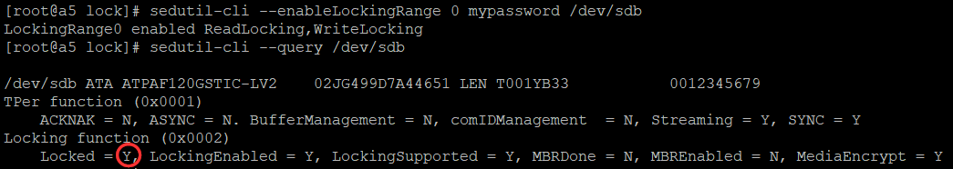
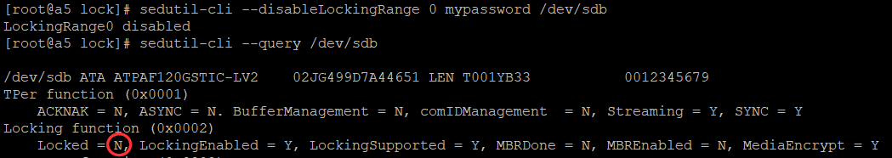
sedutil commands – activate/lock/unlock
sedutil-cli --activateLockingSP : change the state of the Locking SP to active
sedutil-cli --enableLockingRange : activate a locking range
sedutil-cli --disableLockingRange : deactivate a locking range

Slide 16
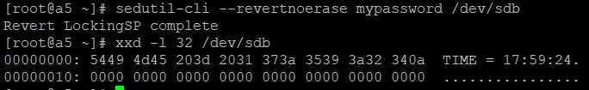
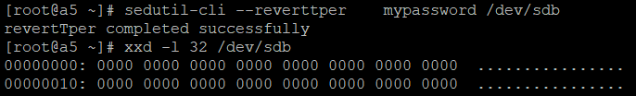
sedutil commands - revert
sedutil-cli -- revertnoerase : deactivate the Locking SP without erasing the data
sedutil-cli -- reverttper : reset the device to it’s factory defaults using the SID password
sedutil-cli -- PSIDrevert : Reset the device to it’s factory defaults using the PSID

Slide 17
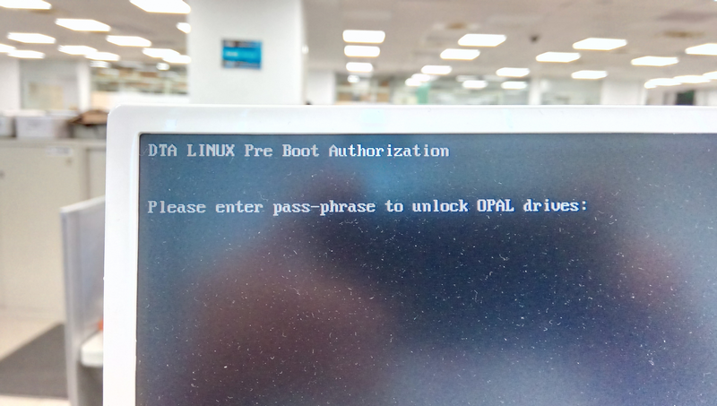
sedutil commands - PBA
Pre-boot authentication (PBA) serves as an extension of the BIOS, UEFI or boot firmware and guarantees a secure, tamper-proof environment external to the operating system as a trusted authentication layer.
The PBA prevents anything being read from the hard disk such as the operating system until the user has confirmed they have the correct password or other credentials including multi-factor authentication

Slide 18
sedutil commands - PBA
Steps to create a PBA drive: $ sedutil-cli --initialsetup mypassword /dev/nvme0 # Setup the device for use with sedutil
takeOwnership complete
Locking SP Activate Complete
LockingRange0 disabled
LockingRange0 set to RW
MBRDone set on
MBRDone set on
MBREnable set on
Initial setup of TPer complete on /dev/nvme0
$ sedutil-cli --enablelockingrange 0 mypassword /dev/nvme0 # Enable a Locking Range ; 0 = GLobal
LockingRange0 enabled ReadLocking,WriteLocking
$ sedutil-cli --setlockingrange 0 lk mypassword /dev/nvme0 # Set the status of a Locking Range ; 0 = GLobal
LockingRange0 set to LK
$ sedutil-cli --setmbrdone off mypassword /dev/nvme0 # Set/Unset MBRDone
MBRDone set off
$ wget https://github.com/Drive-Trust-Alliance/exec/raw/master/UEFI64.img.gz # download img
$ gunzip UEFI64-1.15.1.img.gz # unzip img
$ sedutil-cli --loadpbaimage mypassword UEFI64.img /dev/nvme0 # Write img to MBR Shadow area
Writing PBA to /dev/nvme0
33554432 of 33554432 100% blk=4734
PBA image UEFI64.img written to /dev/nvme0

